Slide 1
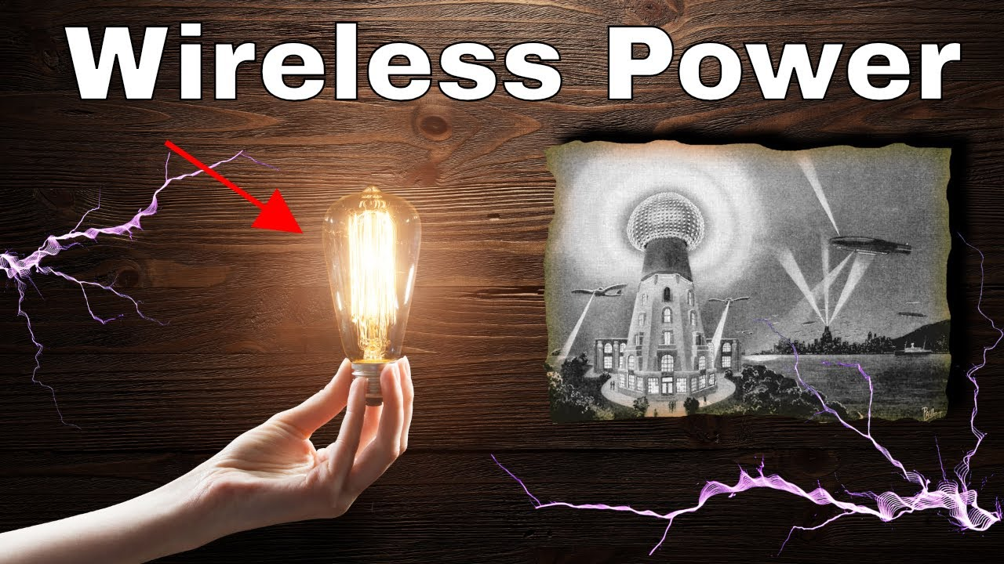



Wireless Power Transfer (WPT)
Presenter : Saifur Rahman
Communication Theory Lab
Course: ENGR 574
Instructor : Dr. Loic Markley

Slide 2


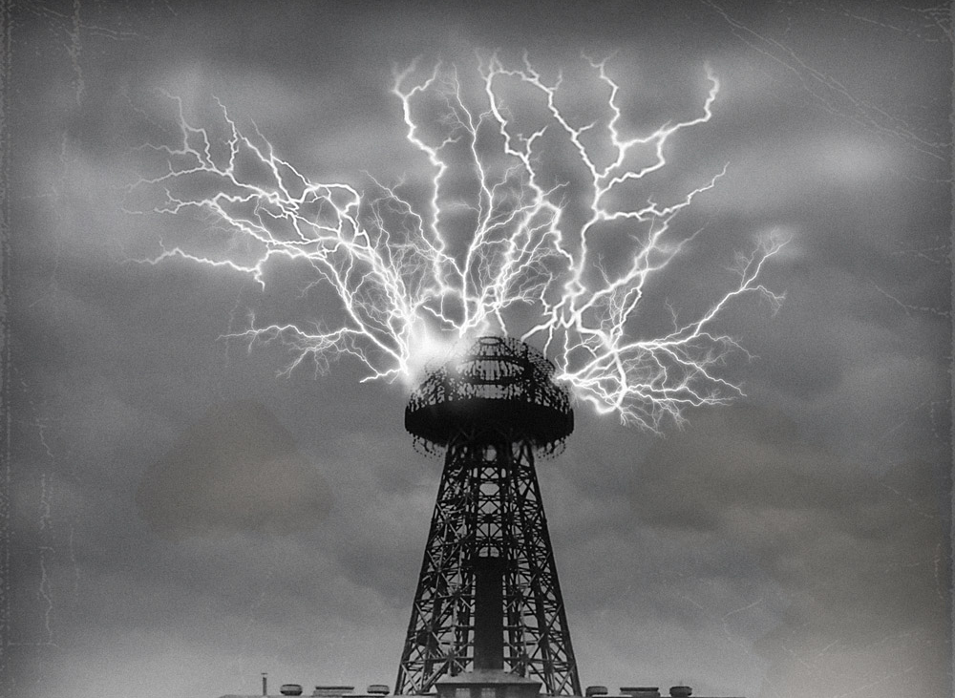
Brief History….
James Clerk Maxwell (1868)
John Henry Poynting (1884)
Heinrich Rudolf Hertz (1888)
Nikola Tesla (1891-1904)
Tesla Tower Colorado Springs

Slide 3
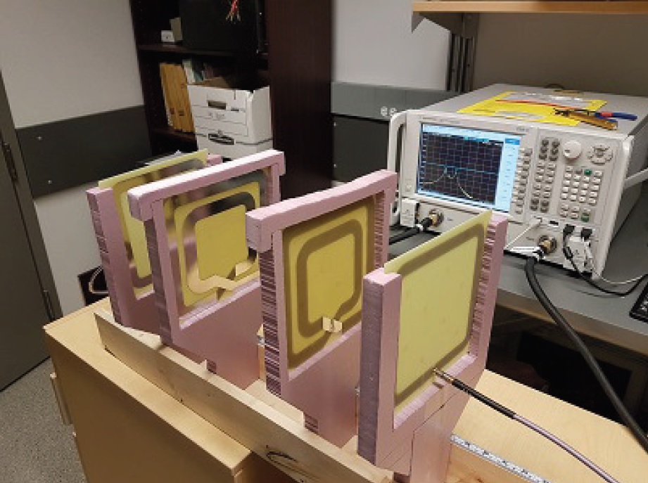
Similar Work by our Prof!
Title: Idle Power Loss Suppression in Magnetic
Resonance Coupling Wireless Power Transfer
MRC WPT system
Suppresses power loss in idle state
Maximum Power transfer under conjugate matching
Source: https://ieeexplore.ieee.org/document/8310570

Slide 4
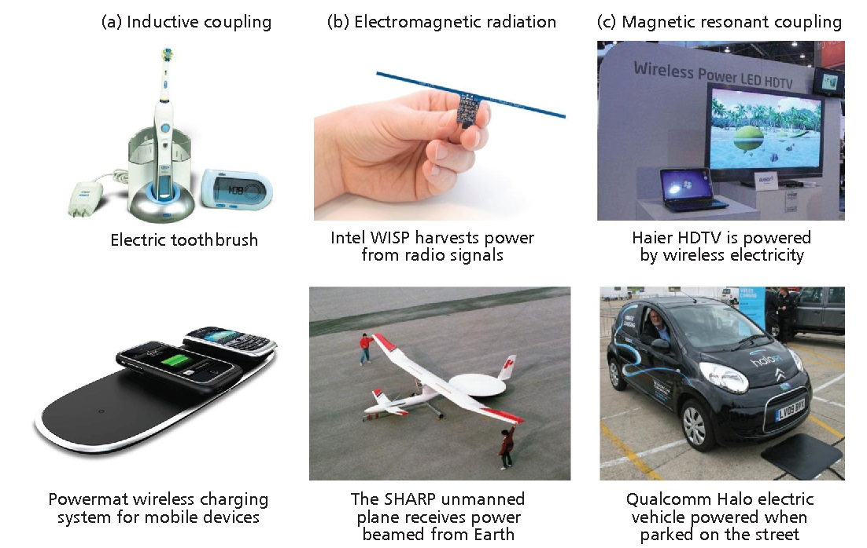
Applications:
Mobile Phones
Electric Vehicles
Medical implants
Wireless Sensor Networks
Unmanned Vehicles

Slide 5
Categories of WPT:
Magnetic resonant
Inductive
Capacitive
Magneto Dynamic
Near Field
Far Field

Slide 6
WPT System: Generic Block Diagram
Load/
Power Device
DC Power
Source
Voltage Regulator
DC
DC
TX Antenna
RX Antenna
AC
AC
Oscillator
Rectifier

Slide 7
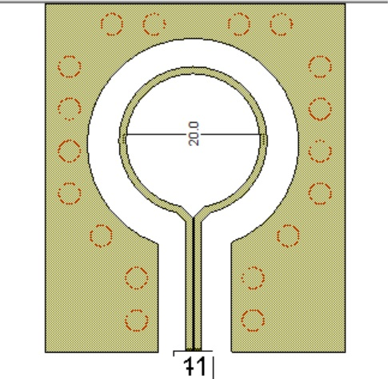
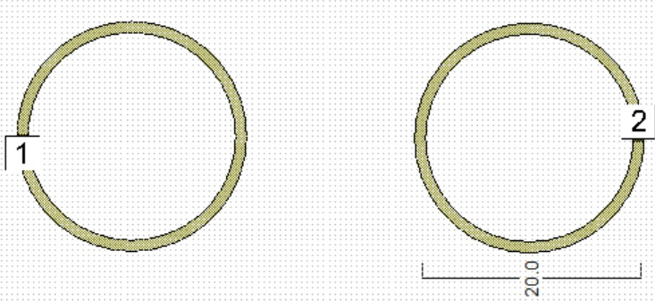
Antenna Constructions: Loop Antenna
Single Loop
2-Loop: Transmitter & Receiver
d
1-Excitation Port
2- Load Port

Slide 8
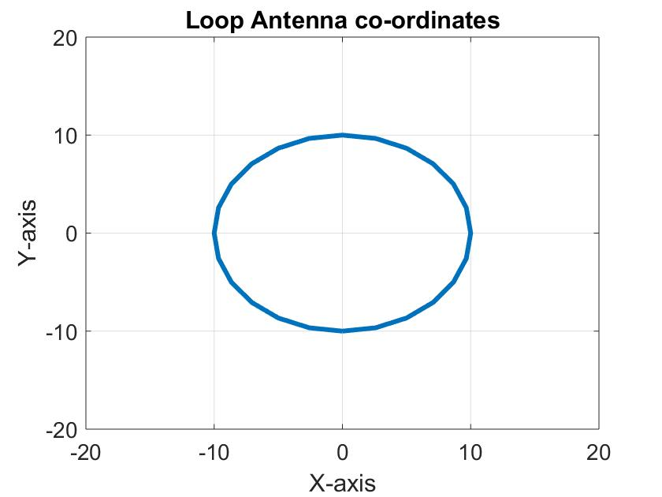
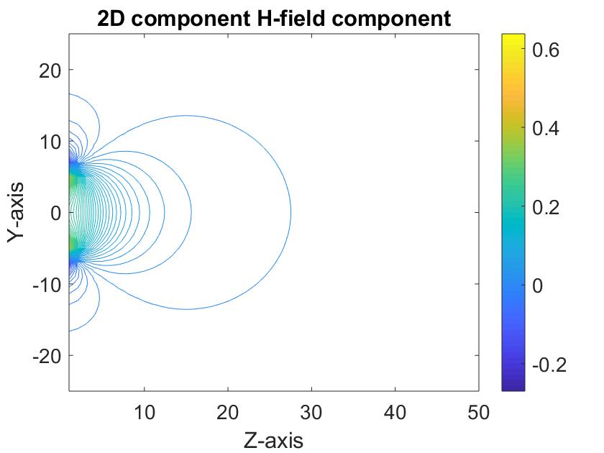
Loop Antenna: H-Field Pattern (MATLAB)
Elliptical Loop
H-Field Pattern

Slide 9
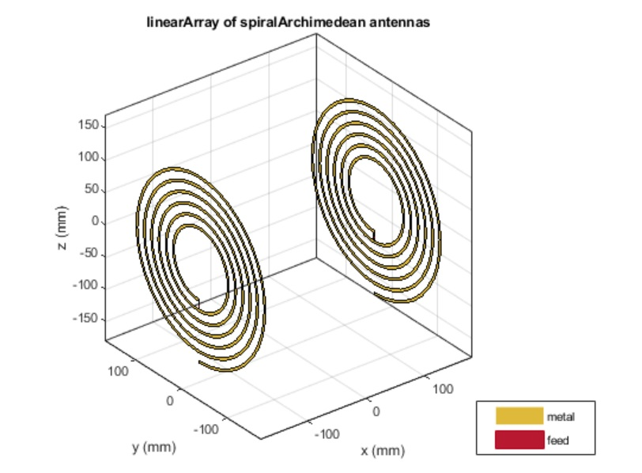
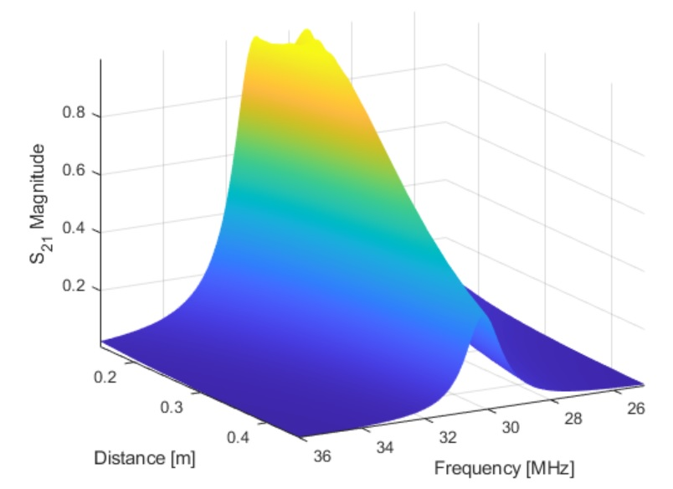
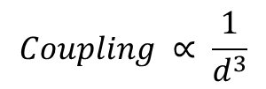
Spiral Archimedean Toolbox: Resonance Behavior
Spiral Archimedean Resonators
3D-plot of Resonator
$$Coupling ∝ \frac{1}{d^{3}}$$
Source:https://www.mathworks.com/help/antenna/ug/modeling-resonant-coupled-wireless-power-transfer-system.html

Slide 10
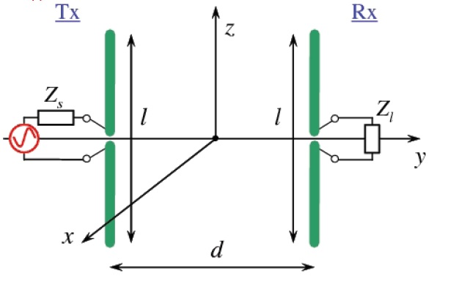
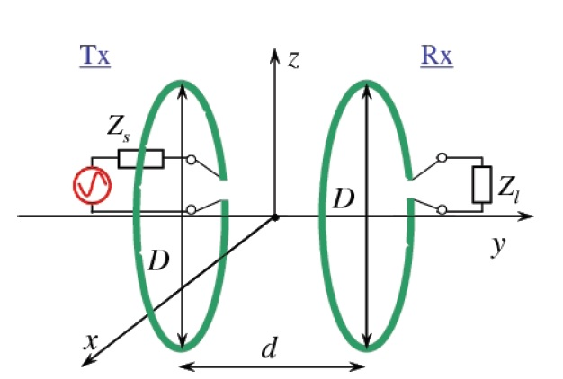
WPT System Design: Using Dipole & Loop Antenna
Dipole System
Loop System
l- length
d- distance
D- diameter
d- distance

Slide 11
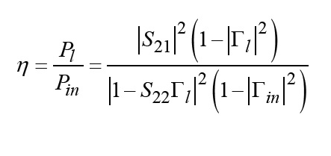
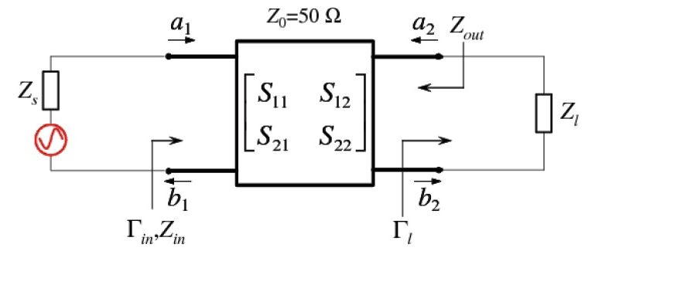
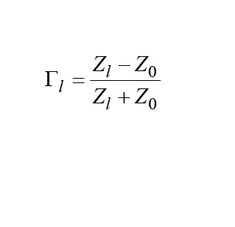
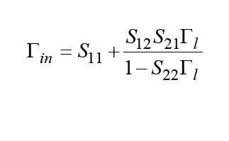
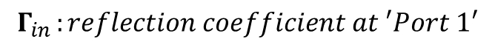
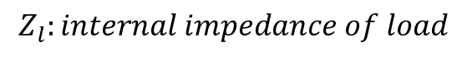
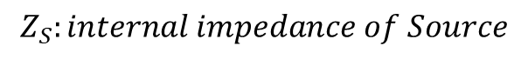
Analysis & Model: Two Port Equivalent Circuit
Power Transmission Efficiency
Two-port equivalent circuit for WPT
$S_{ij} : S− parameter of 2 port Network$
$$Γ_{l }:reflection coefficient at the load Z_{l}$$
$$Z_{S}:internal impedance of Source$$
$$Γ_{in }:reflection coefficient at ′Port 1′$$
$$Z_{l}:internal impedance of load$$

Slide 12
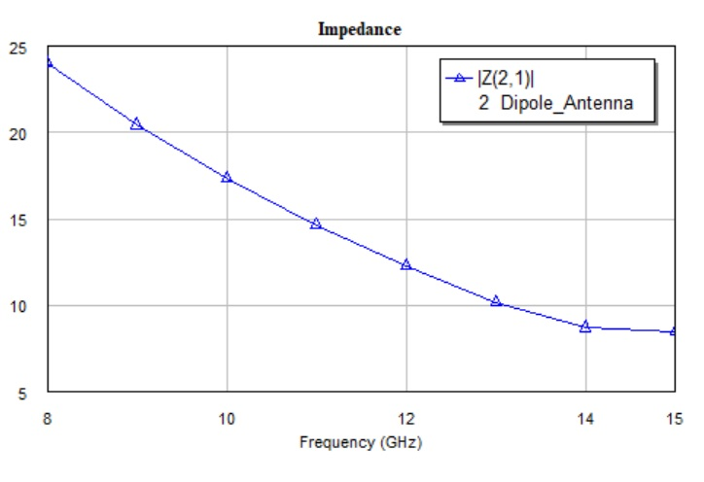
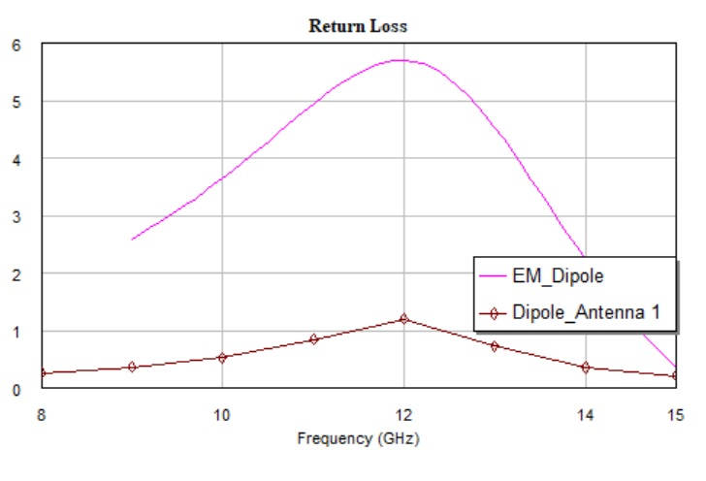
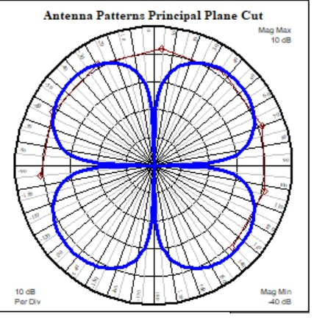
Simulation Results: Dipole-Dipole System
Impedance
Antenna Pattern
Return Loss
Impedance

Slide 13
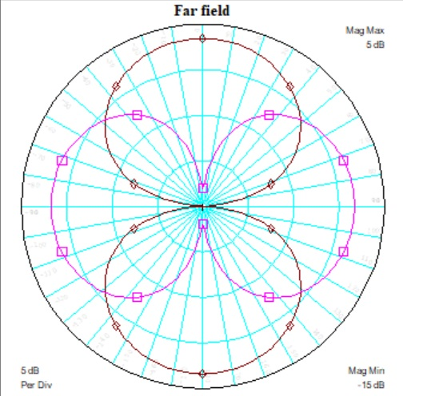
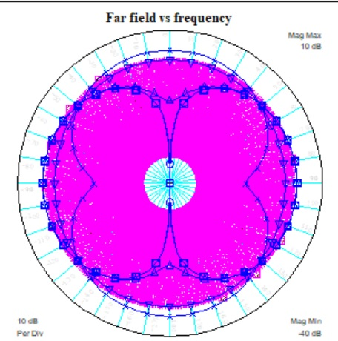
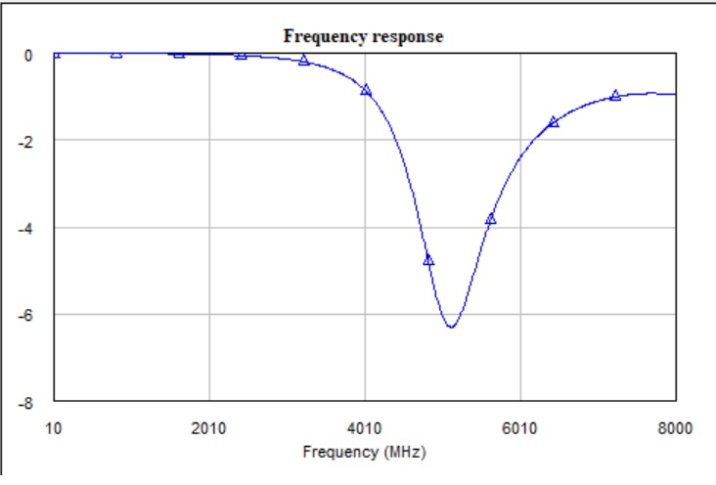
Simulation Results: Loop-Loop System
Far-field E.field
Far Field Vs Frequency
Frequency Response

Slide 14
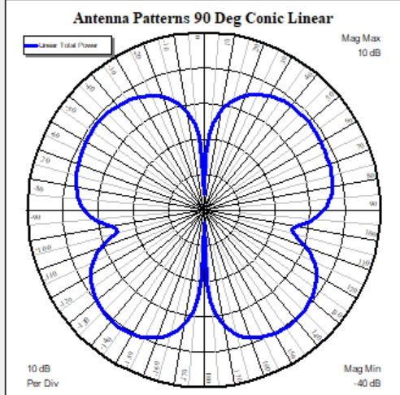
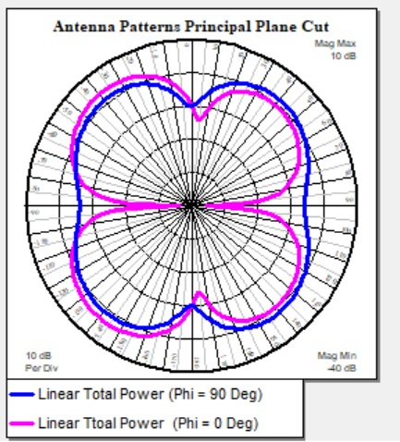
Simulation Results: Dipole-Loop System
Linear Total power
at different φ
Linear Power of Dipole
as Receiver

Slide 15
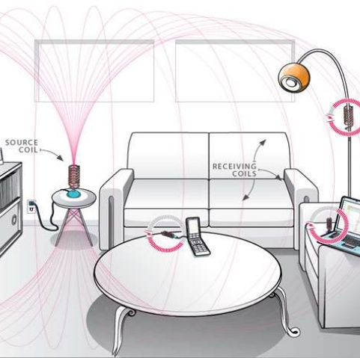
Future Potentials of WPT:
High Density Power Devices
High Efficiency Power Devices
Innovative circuit architectures
Low-power Integrated Circuit

Slide 16
References:
Badowich, C., & Markley, L. (2018). Idle Power Loss Suppression in Magnetic Resonance Coupling Wireless Power Transfer. IEEE Transactions on Industrial Electronics, 65(11), 8605–8612. doi: 10.1109/tie.2018.2813958
Badowich, Connor, Rousseau, J, Markley, L. “Convex Optimization of Coil Spacing in Cascaded Multi-Coil Wireless Power Transfer.” Wireless Power Transfer, 2020, pp. 1–9., doi:10.1017/wpt.2020.5.
Chen, Q., Ozawa, K., Yuan, Q., & Sawaya, K. (2012). Antenna Characterization for Wireless Power-Transmission System Using Near-Field Coupling. IEEE Antennas and Propagation Magazine, 54(4), 108–116. doi: 10.1109/map.2012.6309161
Kim, H.-S., Won, D.-H., & Jang, B.-J. (2010). Simple design method of wireless power transfer system using 13.56MHz loop antennas. 2010 IEEE International Symposium on Industrial Electronics. doi: 10.1109/isie.2010.5636910

Slide 17
Thank You

